Slide 1
Lecture 7
Solving systems of linear equations with the PA=LU decomposition

Slide 2
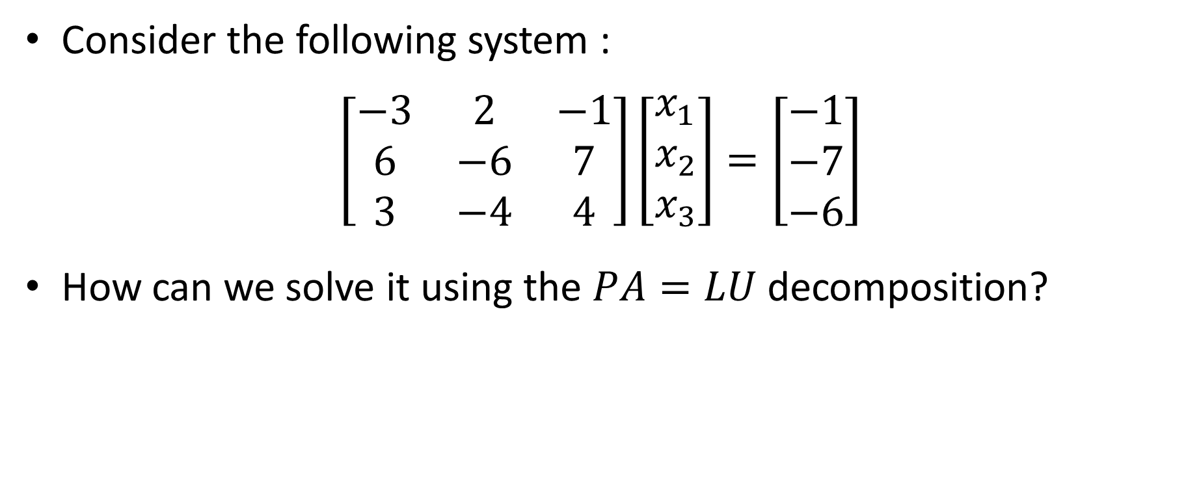
Introduction
Consider the following system :
$$\left[\begin{matrix}−3 & 2 & −1 \\ 6 & −6 & 7 \\ 3 & −4 & 4\end{matrix}\right]\left[\begin{matrix}x_{1} \\ x_{2} \\ x_{3}\end{matrix}\right]=\left[\begin{matrix}−1 \\ −7 \\ −6\end{matrix}\right]$$
How can we solve it using the $PA=LU$ decomposition?
Notes:
In this lecture we will learn how we can apply the PA=LU decomposition in order to solve systems such as the one displayed

Slide 3
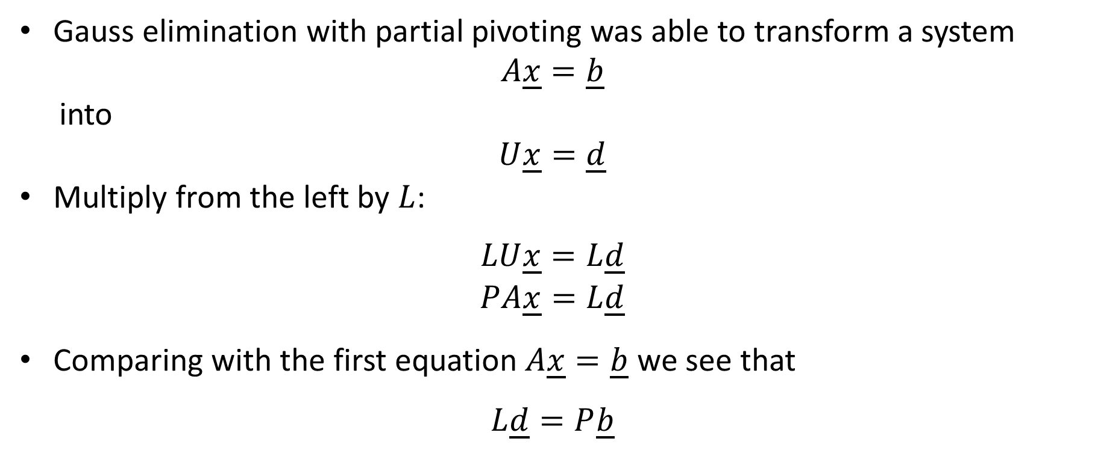
Gauss elimination with partial pivoting was able to transform a system
$$A\underline{x}=\underline{b}$$
into
$$U\underline{x}=\underline{d}$$
Multiply from the left by $L$:
$$LU\underline{x}=L\underline{d}$$
$$PA\underline{x}=L\underline{d}$$
Comparing with the first equation $A\underline{x}=\underline{b}$ we see that
$$L\underline{d}=P\underline{b}$$
Notes:
To derive the algorithm we proceed the same way we did in the lecture on the LU decomposition
We start from the system Ax=b we want to solve
Gauss algorithm with partial pivoting was able to transform it into a upper diagonal system Ux=d
Multiply form the left this system by L
We obtain LUx=Ld
But LU is equal to PA
Consequently we can write
PAx=Ld
Comparing with the equation Ax=b, we note that Ld must be equal to Pb.
This simple calculation gives us the algorithm to solve a system using the PA=LU decomposition

Slide 4
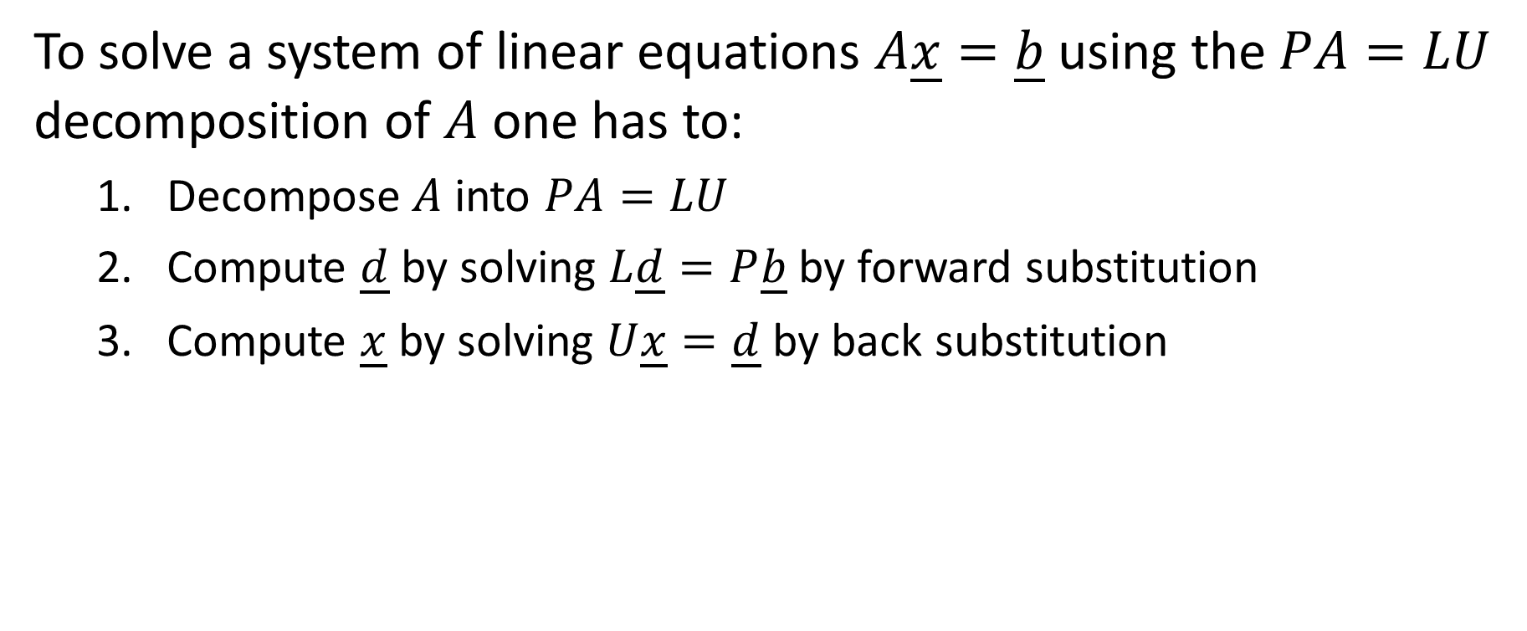
Solving system of linear equations with the LU decomposition
To solve a system of linear equations $A\underline{x}=\underline{b}$ using the $PA=LU$ decomposition of $A$ one has to:
Decompose $A$ into $PA=LU$
Compute $\underline{d}$ by solving $L\underline{d}=P\underline{b}$ by forward substitution
Compute $\underline{x}$ by solving $U\underline{x}=\underline{d}$ by back substitution
Notes:
To solve a system of linear equations $A\underline{x}=\underline{b}$ using the PA=LU decomposition of $A$ one proceeds in three steps
First: decompose $A$ into P$A=LU$
Second: compute $\underline{d}$ by solving $L\underline{d}=P\underline{b}$ by forward substitution
And third: compute $\underline{x}$ by solving $U\underline{x}=\underline{d}$ by back substitution
Note the difference in step 2 compared to the LU decomposition algorithm
The system to be solved is Ld=Pb and not Ld=b
The reason is that the pivoting strategy does not only apply to the coefficients of the unknowns but to the right hand-side of the equation too.
Consequently one has to switch the entries in the right hand-side vector b the same way as one switches the rows in the coefficient matrix.
The switching operations being encoded in the permutation matrix P one perform these operations by computing P times b.

Slide 5
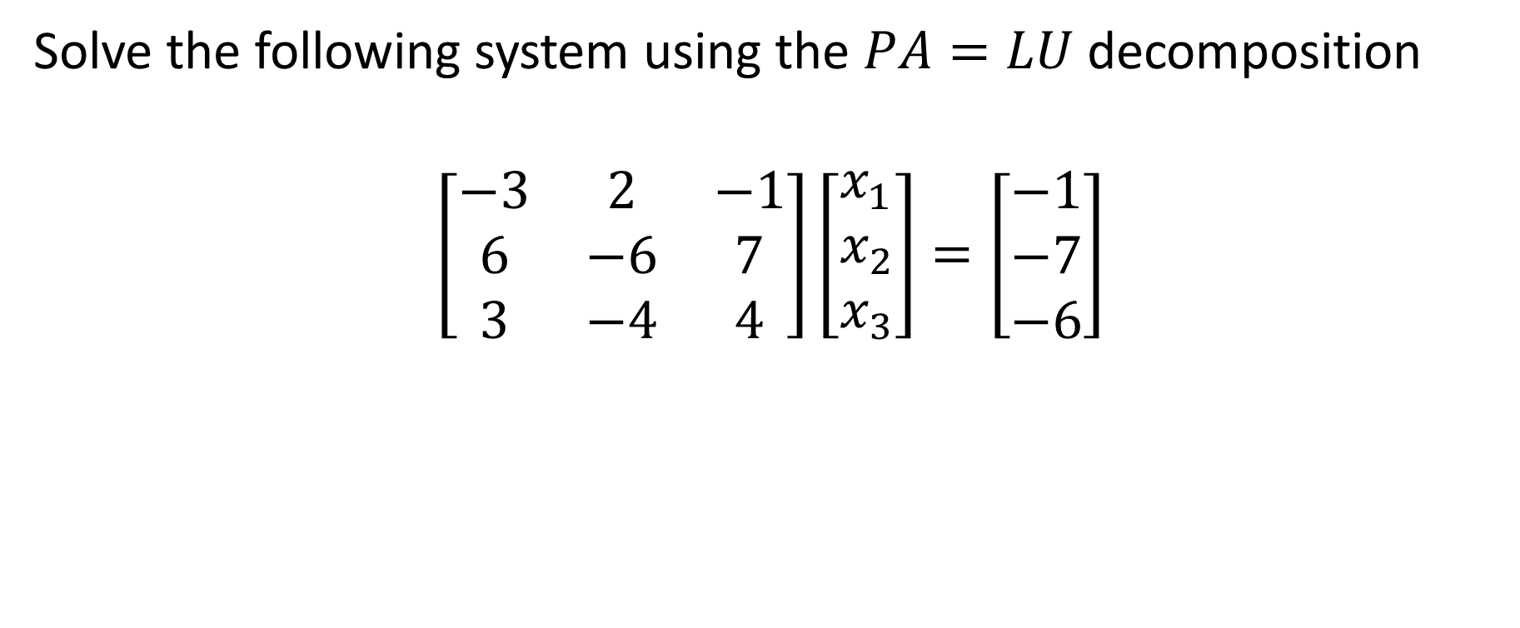
Example
Solve the following system using the $PA=LU$ decomposition
$$\left[\begin{matrix}−3 & 2 & −1 \\ 6 & −6 & 7 \\ 3 & −4 & 4\end{matrix}\right]\left[\begin{matrix}x_{1} \\ x_{2} \\ x_{3}\end{matrix}\right]=\left[\begin{matrix}−1 \\ −7 \\ −6\end{matrix}\right]$$
Notes:
Let us illustrate this algorithm with an example
We will solve the displayed system

Slide 6

Example – Step 1
First find the $PA=LU$ decomposition of $A$:
$$\left[\begin{matrix}0 & 1 & 0 \\ 1 & 0 & 0 \\ 0 & 0 & 1\end{matrix}\right]\left[\begin{matrix}−3 & 2 & −1 \\ 6 & −6 & 7 \\ 3 & −4 & 4\end{matrix}\right]=\left[\begin{matrix}1 & 0 & 0 \\ −1/2 & 1 & 0 \\ 1/2 & 1 & 1\end{matrix}\right]\left[\begin{matrix}6 & −6 & 7 \\ 0 & −1 & 5/2 \\ 0 & 0 & −2\end{matrix}\right]$$
Notes:
First we need the PA=LU decomposition of the coefficient matrix
I invite you to find the decomposition using the method we learned in previous lecture.

Slide 7
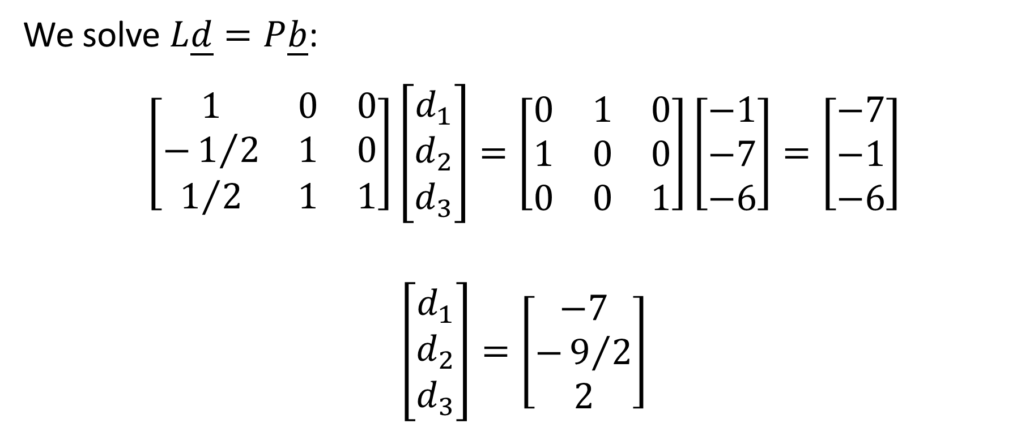
Example – Step 2
We solve $L\underline{d}=P\underline{b}$:
$$\left[\begin{matrix}1 & 0 & 0 \\ −1/2 & 1 & 0 \\ 1/2 & 1 & 1\end{matrix}\right]\left[\begin{matrix}d_{1} \\ d_{2} \\ d_{3}\end{matrix}\right]=\left[\begin{matrix}0 & 1 & 0 \\ 1 & 0 & 0 \\ 0 & 0 & 1\end{matrix}\right]\left[\begin{matrix}−1 \\ −7 \\ −6\end{matrix}\right]=\left[\begin{matrix}−7 \\ −1 \\ −6\end{matrix}\right]$$
$$\left[\begin{matrix}d_{1} \\ d_{2} \\ d_{3}\end{matrix}\right]=\left[\begin{matrix}−7 \\ −9/2 \\ 2\end{matrix}\right]$$
Notes:
In the second step we compute d by solving Ld=Pb
As L is a lower diagonal matrix, the solution is simple to obtain.
As in the LU decomposition algorithm we use forward substitution to get it.

Slide 8

Example – Step 3
We solve $U\underline{x}=\underline{d}$:
$$\left[\begin{matrix}6 & −6 & 7 \\ 0 & −1 & 5/2 \\ 0 & 0 & −2\end{matrix}\right]\left[\begin{matrix}x_{1} \\ x_{2} \\ x_{3}\end{matrix}\right]=\left[\begin{matrix}−7 \\ −9/2 \\ 2\end{matrix}\right]$$
$$\left[\begin{matrix}x_{1} \\ x_{2} \\ x_{3}\end{matrix}\right]=\left[\begin{matrix}2 \\ 2 \\ −1\end{matrix}\right]$$
Notes:
The third and last step is to compute x by solving Ux=d.
This is done by back-substitution.
I recommend you to repeat the solution of this system using Gauss elimination with partial pivoting instead of the PA=LU decomposition
You will realize that the back-substitution step of the Gauss algorithm is exactly the same as step 3 of the PA=LU decomposition.
In fact, the Gauss algorithm will transform the original system in exactly the system Ux=d displayed here.

Slide 9

Using Octave / Matlab
In Octave / Matlab the backslash command “\” implements the $PA=LU$ decomposition to solve systems
Example:
octave> A = [-3 2 -1; 6 -6 7; 3 -4 4]; b = [-1; -7; -6];
octave> A\b
ans =
2
2
-1
Notes:
In octave or matlab the backslash command implements the $PA=LU$ decomposition to solve systems
For the example we just did the steps are the following:
First we define the coefficient matrix A and the right hand side vector b.
To solve the system Ax=b using PA=LU decomposition one uses the command “A\b”
Executing the command leads to the desired solution

Slide 10
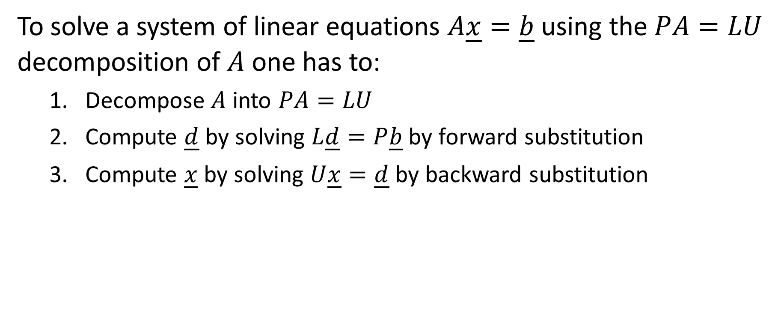
Summary
To solve a system of linear equations $A\underline{x}=\underline{b}$ using the $PA=LU$ decomposition of $A$ one has to:
Decompose $A$ into $PA=LU$
Compute $\underline{d}$ by solving $L\underline{d}=P\underline{b}$ by forward substitution
Compute $\underline{x}$ by solving $U\underline{x}=\underline{d}$ by backward substitution
Notes:
Let us summarize the key findings
To solve a system of linear equations $A\underline{x}=\underline{b}$ using the PA=LU decomposition of $A$ one has to:
First decompose $A$ into $PA=LU$
Second compute $\underline{d}$ by solving $L\underline{d}=P\underline{b}$ by forward-substitution
And third compute $\underline{x}$ by solving $U\underline{x}=\underline{d}$ by back-substitution

